Slide 1

DEVELOPMENT AND DEPLOYMENT OF AN ADVANCED AI-DRIVEN LOAN APPROVAL SYSTEM
AKANDE ABDUL-HAKEEM

Slide 2
UNDERSTANDING HOW THE TRADITIONAL LOAN SYSTEM HAS WORKED
A loan is a form of debt incurred by an individual or group in order to meet a financial obligation at a point in time. A plan for repayment is agreed upon the loan approval with a variable interest rate depending on a number of factors but majorly:
The amount for the loan.
The planned repayment period (how long before the loaned amount ).
The purpose of the loan(what it will be used for).
Proof of steady income/returns, etc
Loan history, transaction and other factors can affect the borrowers chances of getting a loan

Slide 3

THE DOWNSIDES AND LIMITATIONS TO THE TRADITIONAL LOAN SYSTEM
At its worst form, an incident like the 2008 financial crisis can occur.
The traditional loan approval process can be time-consuming and labor-intensive.
The traditional loan approval process may not be accessible to individuals who lack a robust credit history or collateral.
Traditional loan approval processes was often bias.
Notes:
At its worst form, an incident like the 2008 financial crisis can occur due to loans given to borrowers with poor credit history, excessive leverage on booming house market.
The traditional loan approval process may not be accessible to individuals who lack a robust credit history or collateral.
Traditional loan approval processes often rely heavily on subjective judgments made by loan officers or underwriters, which can introduce bias and inconsistency into the decision-making process

Slide 4

THE FUTURE OF LOAN APPROVAL
PROCESS
The implementation of artificial intelligence (AI) and machine learning (ML) in the loan processing industry is expected to significantly transform the way loans are approved, underwritten, and managed. Here are some potential changes that may shape the future of the loan process:
AUTOMATED DECISION MAKING
ENHANCED FRAUD DETECTION
INCREASED ACCURACY IN CREDIT SCORING
IMPROVED RISK MANAGEMENT
Notes:
1. Automated decision-making: AI/ML algorithms can analyze a vast amount of data much faster and more accurately than humans, enabling real-time credit decisions without manual intervention. This will lead to faster loan approval times and reduced risk of human bias in decision-making.
2. Enhanced fraud detection: ML models can detect fraudulent activities such as identity theft and credit card scams more effectively than traditional methods, reducing the risk of fraudulent loans.
3. Increased accuracy in credit scoring: ML algorithms can analyze a borrower's credit history and identify patterns that may not be captured by traditional credit scoring models, leading to more accurate credit scores and reduced risk of default.
4. Improved risk management: AI/ML can help lenders identify potential risks associated with individual borrowers or loans, allowing them to take preventive measures to mitigate those risks.
Automated decision-making
Enhanced fraud detection
Increased accuracy in credit scoring
Improved risk management
Increased accessibility
Regulatory compliance

Slide 5
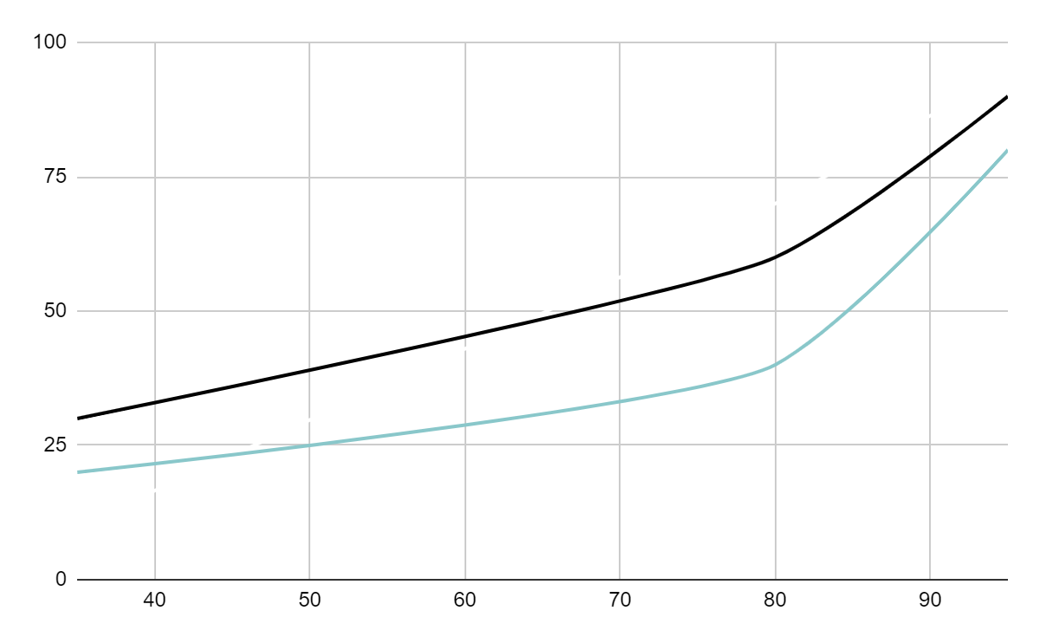
THE ESTIMATED IMPACT OF IMPLEMENTING AN AI/ML BASED SOLUTION
CUSTOMER BASE
Valid applicants can be identified easily.
PROFIT
Steady and consistent influx of cash.
TIME SAVED
The timed saved on application processing going forward increases.

Slide 6
A LOOK INTO MY SOLUTION
FRONT END
ML ALGORITHM
HTML BOOTSTRAP OR STREAMLIT
PARSING APPLICANT INFORMATION
APPLICANT
SERVER
APPLICANT PROVIDING REQUIRED DETAILS
PYTHON FLASK SERVER
Notes:
APPLICANT => ENTERS THE REQUIRED INFO
FRONT-END => FORM CONSISTING OF THE REQUIRED INFO
SERVER => STORING USER INFO AND PASSING TO THE ML-ALGO
ML ALGORITHM => PARSING APPLICANT INFORMATION

Slide 7
TECHNOLOGY IMPLEMENTATION STACK
FRONTEND | HTML/ STREAMLIT
BACKEND | PYTHON,FLASK
ML MODEL | CLASSIFICATION MODELS -> RANDOM FOREST, LOGISTIC REGRESSION, LIGHTGBM,XGBOOST, CATBOOST

Slide 8
THE RATIONALE BEHIND MY SOLUTION
Intended to roll out for only personal loans at first.
To fine tune model to determine efficiency before other loan type application
Information such as age, occupation, monthly income, requested loan amount and repayment period will be submitted by applicant
Classification ML-model (logistic regression, random forest) to sort applicants into either Approved or Denied
Notes:
Classification

Slide 9
CURRENT PROGRESS AND CHALLENGES
Progress
Prototype of the front end using html is ready
Sample dataset obtained and processed for use in ML-Model
Pending/Challenges
Ml-Model implementation and testing
Evaluating the accuracy of Ml-Model
Linking Ml-Model, server and front-end
Notes:
In classification problems, the goal is to categorize instances into predefined classes or categories based on their features. Evaluating the performance of a classification model involves assessing how well it predicts the class labels for unseen data. Here are some common evaluation metrics used for classification problems:
F1-Score: The F1-score is the harmonic mean of precision and recall. It provides a balance between precision and recall and is useful when the class distribution is uneven.
F1-Score = 2 × Precision×Recall /Precision + Recall
Precision: Precision is like accuracy, but it only focuses on the positive predictions. It tells us how many of the items we labeled as positive are actually positive.
Recall: Recall is about capturing all the positives. It tells us how many of the actual positive items we managed to label correctly.
Short Comings ->Bias based on data used for training, overfitting, complexity of system

Slide 10
THANK
YOU

